Slide 1
Automatic Gardening System Group Members 1. Shubham Sharma 2. Sourabh Patel 3. Mehek Wadhwani 4. Yash Jain 5. Yashika goyal
Submitted to Department of Information Technology

Slide 2
Project Presentation Outline
Abstract
Introduction
Problem Statement
Survey of Existing Systems
Project Objectives
Requirement Analysis
Solution proposed
Models and Diagrams
The Implementation
Testing
The Outcome Discussions
Conclusions and Limitations

Slide 3
Abstract
Our project envisions the possibilities of automatic watering of the plants. In this project we have extended the concept of automation to the small gardens and farm houses. We implement automatic watering of the plants without any human intervention by detecting the moisture content of the soil using sensors and also sending the data to the cloud. The project works automatically and hence reduces man power.

Slide 4
Introduction
In this Project,we use Internet of things to make an Automatic Gardening System. The system enables watering of plants without any human intervention .The Autogardening system detects the moisture of soil using soil moisture sensor and accordingly water the plants. It makes sure that plants have neither excess nor scarcity of moisture.
In this way we solve our day to day headache of gardening or watering garden or plants.

Slide 5
The Problem Statement
The major problem faced in today’s era is water scarcity and lack of trees in the environment. Since watering of trees is a time-consuming process, it has led to declining greenery around us. Sometimes anticipated to carelessness of people and the water systems are left on, which results in the wastage of water. All these issues ultimately leads to major environmental issues like Global Warming, Water scarcity, Acid rain, etc.
Our project helps to overcome all these problems.

Slide 6
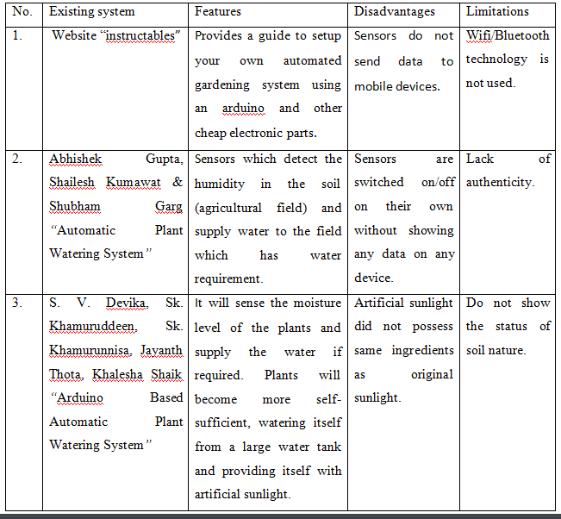
Survey of Existing Systems

Slide 7
Objectives
To design a small-scale automated gardening system for household gardens. This would use water in a more efficient way, in order to prevent water loss and cost of labor.
To irrigate the private gardens.
To send the status and details about the garden and the soil on mobile device.

Slide 8
Requirement Analysis
Functional Requirement
A functional requirement document defines the functionality of a system or one of its subsystems. A function is described as a set of inputs, the behavior and outputs.
Senses soil moisture through soil moisture sensor.
Checking water level through water level sensor.
Moisture comparison
The plants will get watered automatically without the user being physically involved.
User will get notified about all the activities performed by the system.

Slide 9
Requirement Analysis
Non-Functional Requirement
Non-functional requirements detail constraints, targets or control mechanisms for the new system. They describe how, how well or to what standard a function should be provided. In order to assess the performance of a system the following must be clearly specified:
• Reliability:
Our project is reliable and works well in varying circumstances.its reliability basically depends
on internet speed as well as the good weather conditions
• Accuracy:
The sensors used in our implementation give accurate readings of the moisture and water level.
• Availability:
The system is available to all the users. The services are able to the users as long as there is good internet connectivity.
• Supportability:
It is the capability of total system design to support operations and readiness needs throughout the lifecycle of a system at an affordable cost.

Slide 10
Solution Proposed
Our Project “AutoGardening” is basically for the irrigation of private gardens, whenever they want to know details about the garden and the soil.
In the ”AutoGardening” project, the sensor has to feed data about the soil moisture in order to water the plants. This data is then sent to the end user through message and also start the irrigation and stop whenever the necessary amount of water has been given. It will also send the notification to end user about the level of water in tank using sensors.

Slide 11
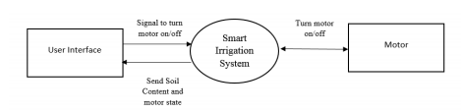
Models/Diagrams
System Design
- Data Flow Diagram (level 0)

Slide 12
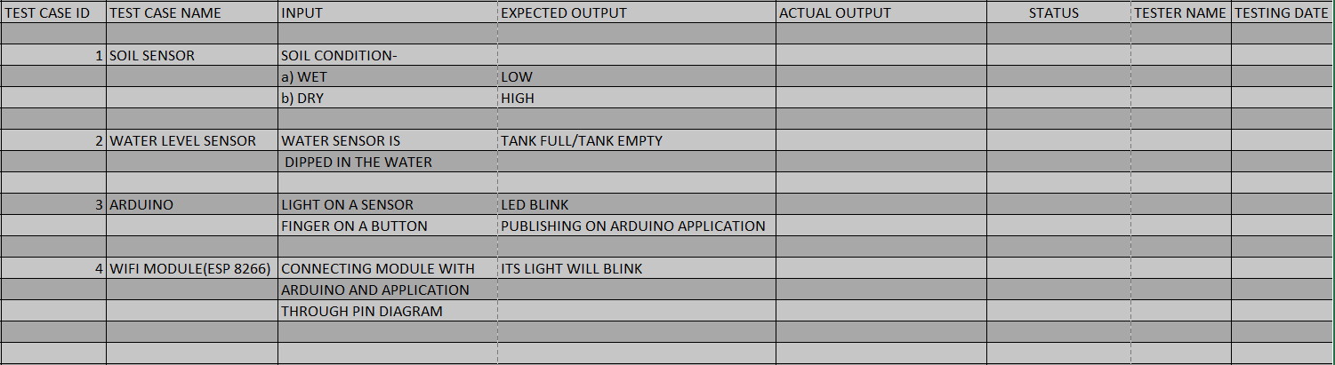
Testing/Test Cases

Slide 13
The Outcome Discussion
In this work, we successfully develop a system that can help in an automated irrigation system by analyzing the moisture level of the ground. The smart irrigation system proves to be a useful system as it automates and regulates the watering without any manual intervention.
Hence, it solves the problem of not been able to water plants regularly and effectively.

Slide 14
Conclusion/Limitation
The primary applications for this project are for farmers and gardeners who do not have enough time to water crops/plants. The moisture sensors and water level sensor measure the moisture level (water content) of the different plants and availability of water.
The system may be further extended for outdoor utilization.
We may use multiple sensors for distinct target group to attain fault tolerence.

